Slide 1
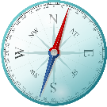
Governing Smart Platforms
5 December 2012, Scotland House
Paul Timmers
Director European Commission
DG CONNECT, Digital Society, Trust and Cybersecurity

Slide 2
GDPR, Privacy Shield, ePrivacy
NIS Directive, eIDAS
EU platforms, collaborative economy
EU free flow of data
EU Consumer Protection
- EU Smart Energy Package
Public policy & regulation
Technology
SMART PLATFORMS
Market actors & forces
Blockchain
Cyber
PDS
Supercomputing
AI
Buyers & Sellers
Givers & Receivers
Sectors 4.0
Providers
?
?
Self-regulation, standards
mHealth Guidelines
Social Charter Smart Platforms
EIP Active & Healthy Ageing Scaling Up
Smart Meters data model
Urban Platforms MoU
Extended Vehicle data definition

Slide 3
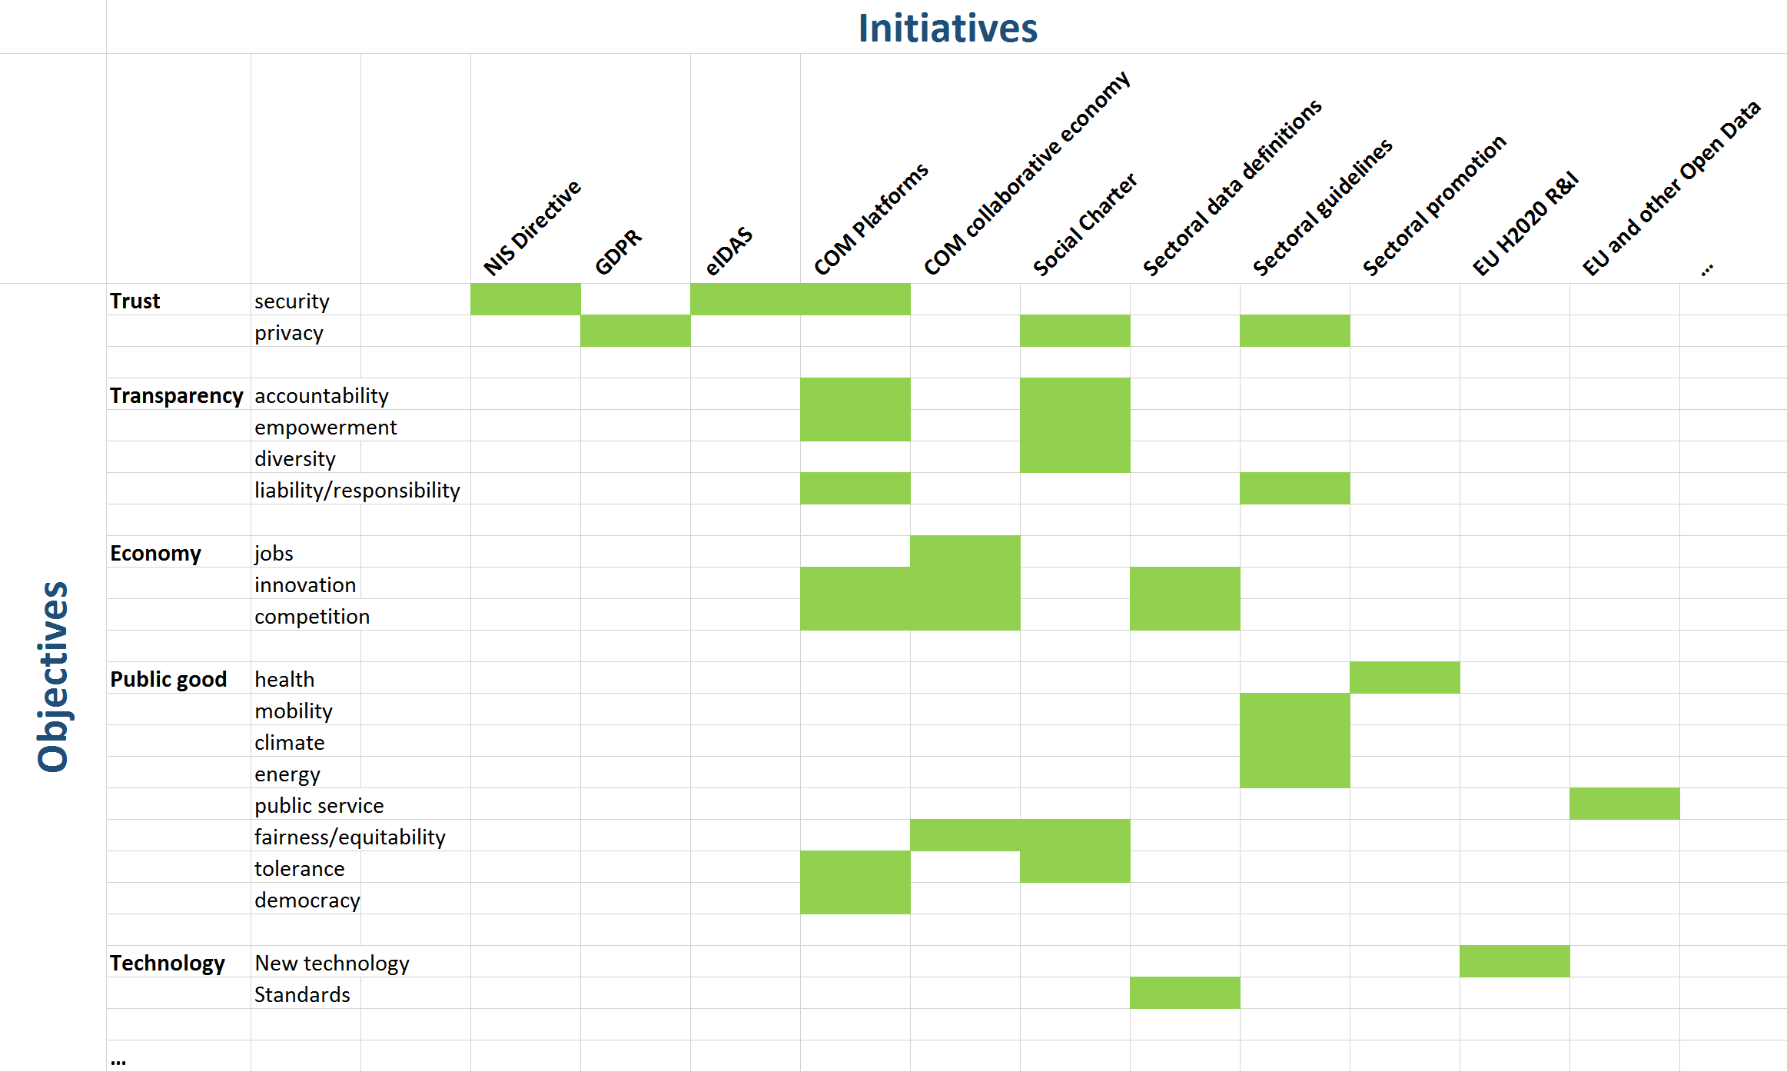
EU Treaty
SMART PLATFORMS

