Slide 1

Digital Footprint Project
Smart Society Policy Event – 05.12.2016
Scotland House
Rond-Point Schuman 6, 1040 Brussels

Slide 2
Table of Content
Introduction
The Research Project
  The Research Design
  The Crowd Working Survey
  Extrapolation
The Case Studies
Future Outlook
  Next Steps
  Expected Project Outcome
Media Attention
Critical Assessment

Slide 3
1) Introduction
Crowd work
  No single definition of ‘crowd work’
  Paid or unpaid (sole or additional source of income)
  Carried out online or offline
  Carried out on the worker’s own premises, on a client’s premises or in a public space
  Various employment statuses
What are the characteristics of the ‘gig economy’?
  Who are the crowd workers?
  What type of work is offered at platforms?
  Which sectors are affected?

Slide 4

2) The Research Project
Project Purpose:
Picture of the digitalized labour market in the EU and beyond
Diversity of new forms of labour and associated labour conditions
Policy proposals
  Conducting crowd working surveys in several Member States
  Conducting crowd working surveys in other continents
Main actors:

Slide 5
The Research Project
- The Research Design -
2016 - 2017
Deliveries
Omnibus surveys (on/offline)
  Types and characteristics of crowd work
Qualitative interviews
  Why people do crowd work
European comparative analysis set within a global context
  Interaction between local-based work with a global dimension
  Identifying challenges related to social security
Factsheets/report
Events

Slide 6
The Research Project
- The Crowd Working Survey -
  Overview of crowd workers
  Income from crowd work
  Age of crowd workers
  Distribution of crowd work in different regions
How often do you tend to find paid work through online platforms?
How often do you do certain types of work using online platforms?
  Crowd work driving
  Crowd work outside of home
  Crowd work from home
How often do you do ‘other things’ online?
  (Re)sell possessions/belongings
  Find a paying guest for accommodation in your home

Slide 7
The Research Project
- Extrapolation -
Samples:
  Representative of the broader populations of crowd workers
  But: cannot state with complete confidence that the % found can be extrapolated to the entire population of these countries
  Next step:
    Conduct a comparable survey using face-to-face and/or telephone method
    Calibration of results

Slide 8
3) The Case Studies
UK
(February)
Sweden
(March)
The Netherlands
(June)
Austria (September)
Germany (November)

Slide 9
The Crowd Workers
Member State | Would be crowd workers (%) | Actual crowd workers (%)
United Kingdom | 21 | 11
Sweden | 24 | 12
The Netherlands | 18 | 12
Austria | 36 | 23
Germany | 22 | 14

Slide 10
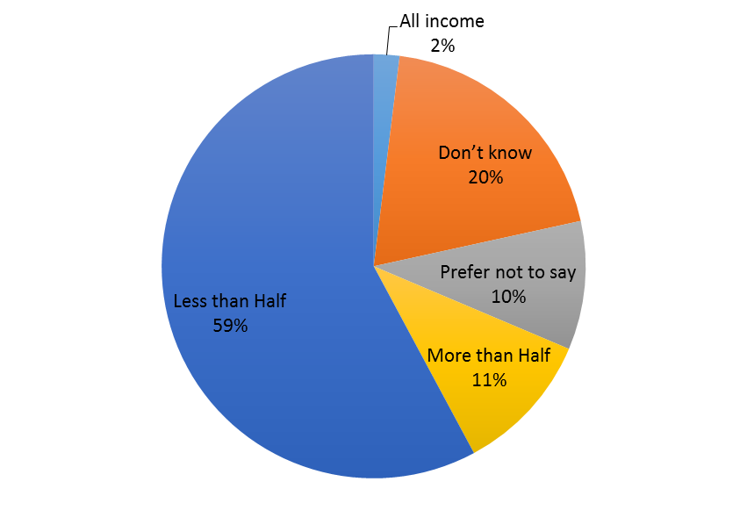
Proportion of Income from
Crowd Work
In the UK (cf. to Sweden)
In Austria (cf. to Germany)

Slide 11
Types of Work being carried out
In Germany
In the Netherlands

Slide 12
Other Sources of Online Income
Swedish Population
(cf. UK + GER)
Austrian Population
(cf. with the NL)

Slide 13
Some existing evidence …
Occasional experiment
Little gender difference
A small supplement to total income
Not narrowly focused on particular types of crowd work

Slide 14
4) Future Outlook
Next steps
Expected project outcome
Publication of the report:
  Review existing evidence on the extent and characteristics of crowd work
  Present the results of an innovative series of surveys
Conducting further crowd working surveys at the European and global level
Producing a final report
Closing the project with a final event
Digitalized labour markets
  Lower labour standards of digitalized workers
  Lower labour costs for the employers of digitalized workers
  Crowd-sourcing practices do not require any payment for income taxes or social contributions
    Lower labour costs for companies
    Large revenue losses for governments in the future

Slide 15
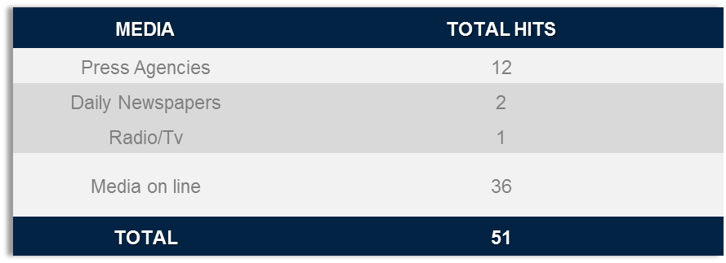
5) Media Attention
In the UK:
  Articles in ‘The Guardian’ and in ‘The Independent’ (14/15 February 2016)
After our Press Conference in Rome (14/15 March 2016):
(Attracted the interest of several EU officials)
In the NL: Publications in 16 regional newspaper and 1 radio interview
In Austria: Publications in 9 newspaper (on + offline) and 1 TV interview
Several academic journals refer to the project

Slide 16
6) Critical Assessment
A specific timeframe is missing …
  When did this trend towards crowd work start?
  How will it develop?
There is no specific data on working hours …
What role do companies play in this development?
+++
Call to action plan
Develop possible scenarios (role of governments, businesses and trade unions)

Slide 17
Publication of the Interim Report on 05.12.2016
For more information: http://www.feps-europe.eu/en/digital-footprint-project
Thank you for your attention.

