Slide 1
Online platforms
Brussels, September 2016

Slide 2
Digital Single Market Strategy Deliverables
Shaping the right environment for digital networks
and services to flourish
Designing rules which match the pace of technology & support infrastructure development.
Pillar 2
DIGITAL ENVIRONMENT
✓
Review the audiovisual media framework
Review online platforms, intermediaries
Review sharing economy
An ambitious overhaul of EU telecoms rules
Reinforce trust and security in digital services
✓
✓
✓
✓

Slide 3
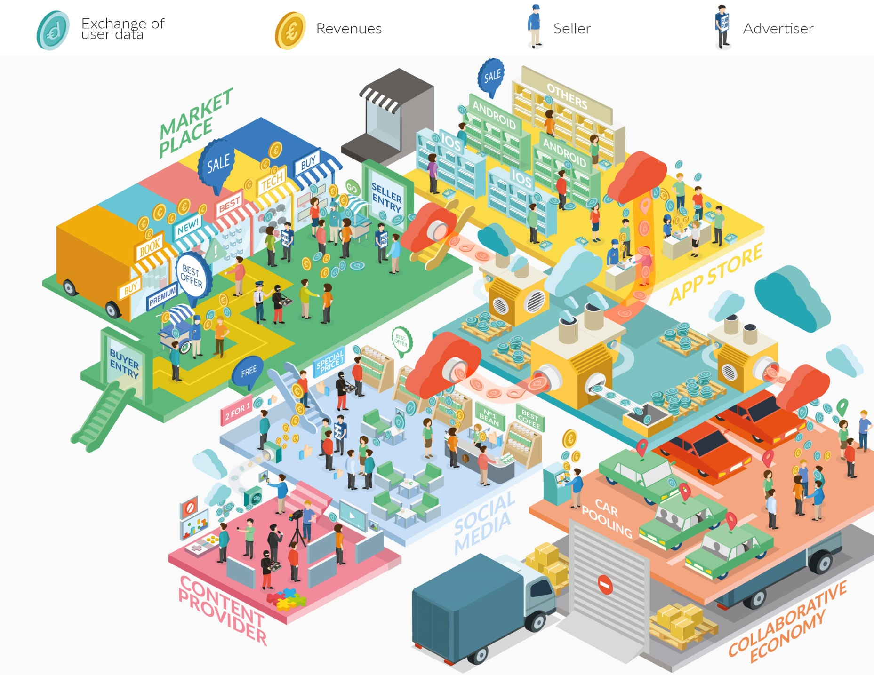
Online platforms Ecosystem

Slide 4
Online platforms Context
How are platforms changing the digital economy?
Bring benefits to the 315 million Europeans who use the internet every day.
Allow market participants to exploit the advantages of digitisation and e-commerce
Have changed the way in which films, music and other creative content is distributed

Slide 5
Online platforms Context
Accessibility of
information
Improved
resource-allocation
Communication
and interaction
60%
Increased
choice
New business
opportunities
0%
Improved
trust
Matching
supply & demand
Lower prices
for consumers
Lower costs for
market reach
Price
transparency
* Results from PC 2015

Slide 6
Online platforms Context
Challenges
Dependence on big platforms:
Central position of some platforms and their relative bargaining power when negotiating terms and conditions with other players raises concerns
Illegal content:
On many online platforms, users can still find illegal content, despite protections already put in place
Switching:
Switching to one platform to another may be difficult for users given the difficulties in transferring their data

Slide 7
Online platforms Context
Challenges
Use of data:
Platforms generate, accumulate and control enormous amounts of data from their users and turn them into usable information.
Transparency:
In some cases it may not be clear whether some platforms have a commercial interest in promoting certain providers when connecting them with customer.

Slide 8
Online platforms Why an EU policy approach?
The EU currently represents only 4% of the total market capitalisation of the largest online platforms and lags behind in terms of start-up platforms
N. America
Europe
Asia
% of total market value
72%
4%
22%
Source: "The Rise of the Platform Enterprise" (The Center for Global Enterprise, 2016)
EU action is needed to set the right environment to attract, retain and grow new online platforms innovators.

Slide 9
Online platforms EU Commission approach
1
Comparable rules for comparable digital services
Comparable digital services will follow same or similar rules
The Commission to reduce scope & extent of existing regulation
2
Obligation for online platforms to behave responsibly
To maintain intermediary liability regime
Specific problems will be addressed through targeted instruments
For example: AVMSD review and code of conduct on combatting hate speech online

Slide 10
Online platforms EU Commission approach
3
Trust is a must
Cross-border enforcement cooperation will ensure that platforms fulfil their obligations regarding consumer rights.
The Commission will also encourage industry to:
Tackle practices such as fake or misleading online reviews.
Recognise different secure electronic identifications (eID)
4
Open markets for a data-driven economy
Free flow of data initiative (scheduled for the end 2016) to facilitate switching and portability of data among different online platforms and cloud computing services

Slide 11
Online platforms EU Commission approach
5
Fair and innovation-friendly business environment
The Commission will analyse issues raised in the public consultation by businesses and suppliers who directly interact with platforms
By spring 2017, the Commission will determine whether additional EU action is needed.

Slide 12
Online platforms
For more information:
Commission updates EU audiovisual rules and presents targeted approach to online platforms
Questions and answers on online platforms and on EU audiovisual rules
Communication on Online Platforms and the Digital Single Market Opportunities and Challenges for Europe

